Slide 1
Probabilistic Programming
Marius Popescu
popescunmarius@gmail.com
2018 - 2019

Slide 2
Introduction

Slide 3
What is Probabilistic Programming
Probabilistic programming languages aim to unify general purpose programming with probabilistic modeling; literally, users specify a probabilistic model in its entirety (e.g., by writing code that generates a sample from the joint distribution) and inference follows automatically given the specification
http://www.probabilistic-programming.org
A programming paradigm that provides a language based on random variables and
stochastic control flow to construct a broad class of probabilistic models

Slide 4
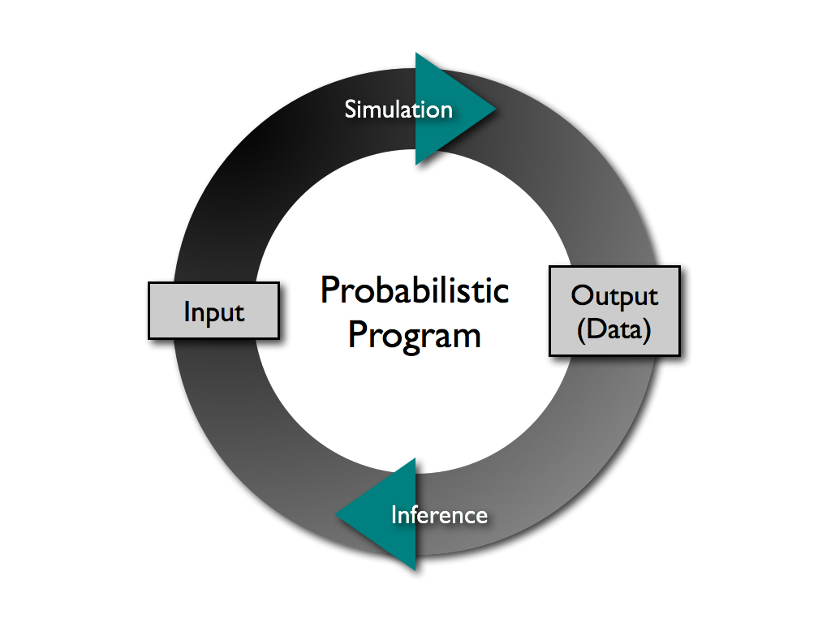
What is Probabilistic Programming

Slide 5
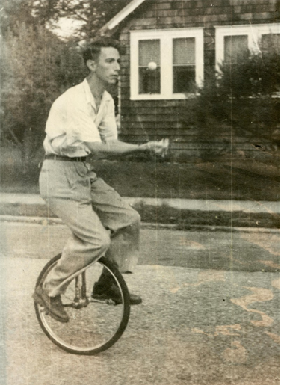
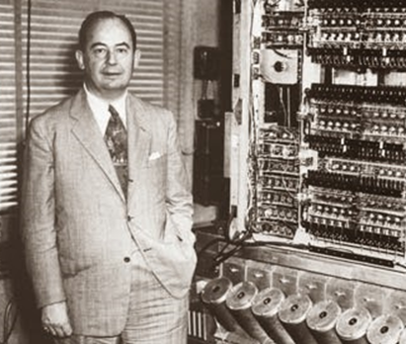
Some History
Von Neumann, J. (1956).
Probabilistic logics and the synthesis of reliable organisms from unreliable components
Shannon, C. E. (1958).
Von Neumann’s contributions to automata theory.

Slide 6
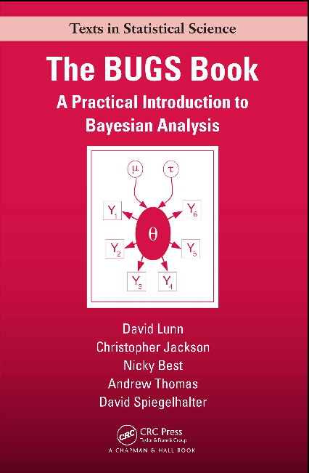
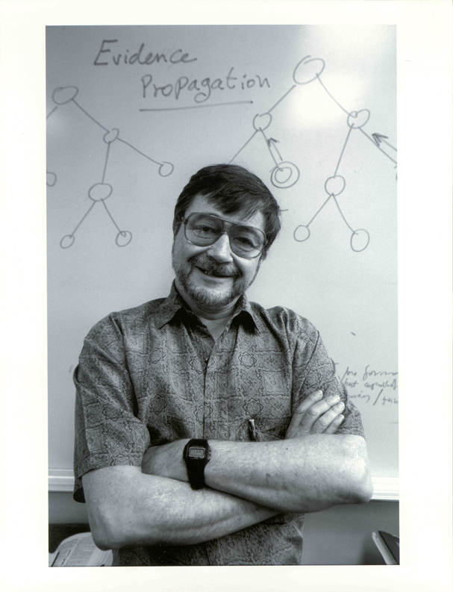
Some History
Pearl, J. (1982).
“Reverend Bayes on inference engines: A distributed hierarchical approach,” Proceedings, AAAI-82
The BUGS (Bayesian inference Using Gibbs Sampling) project is concerned with flexible software for the Bayesian analysis of complex statistical models using Markov chain Monte Carlo (MCMC) methods. The project began in 1989 in the MRC Biostatistics Unit, Cambridge.

Slide 7
Is it useful?
Why to study probabilistic programming?

Slide 8


Slide 12
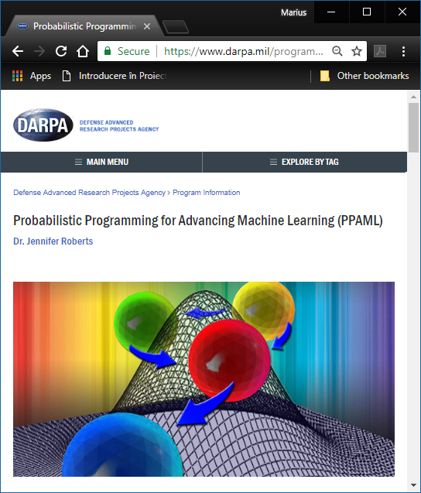
PPAML started in March 2013 and is scheduled to run 46 months, with three phases of activity through 2017

Slide 13
Some Accomplishments

Slide 14
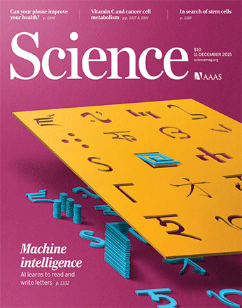

Humans and machines were given an image of a novel character (top) and asked to produce new versions.

Slide 15

Common sense and context affect letter form perception: (i) m vs u and n. (ii) the same line segments are interpreted as N or S depending on occluder positions (iii) perception of the shapes aids the recognition .

Slide 16
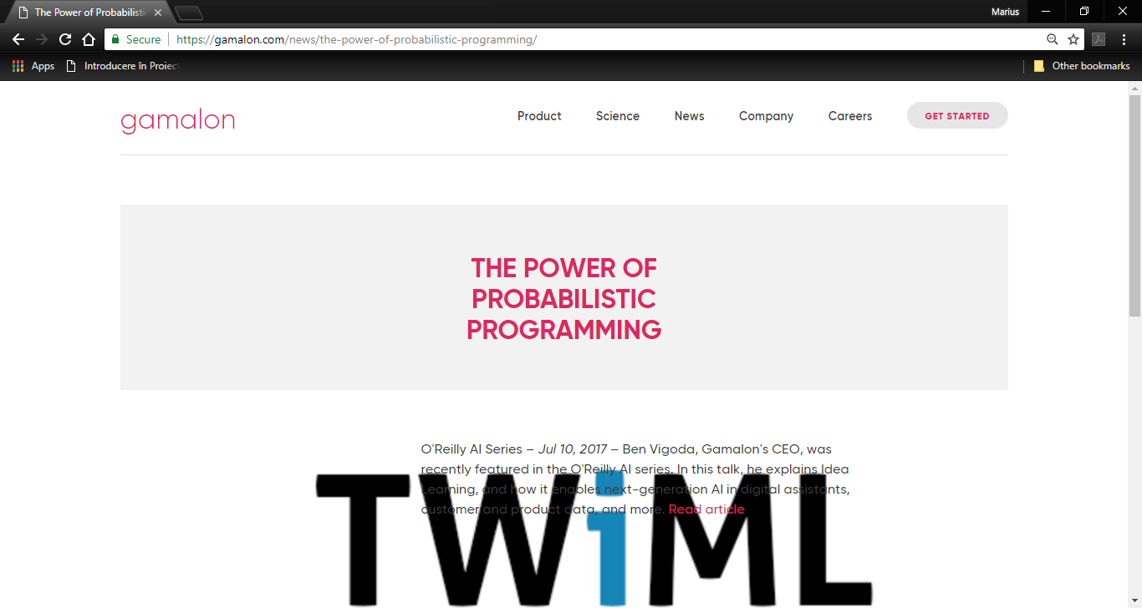

Slide 17
Course Goal & Objectives
Understanding of the basic concepts and mechanisms of the probabilistic programming
Ability of using a probabilistic programming framework (PyMC, Edward)
Using probabilistic programming for building a probabilistic model of a phenomenon, inferring the model parameters given the model and the data, criticizing the model

Slide 18


Tools
PyMC (https://github.com/pymc-devs/pymc)
Edward (http://edwardlib.org/)
TensorFlow Probability Edward2 (tfp.edward2): A probabilistic programming language
(https://github.com/tensorflow/probability/blob/master/tensorflow_probability/python/edward2/README.md)

Slide 19
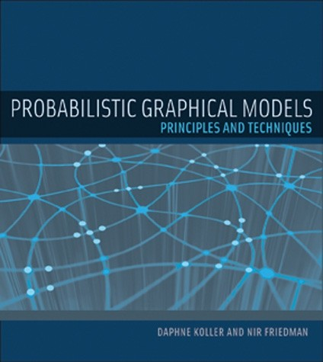
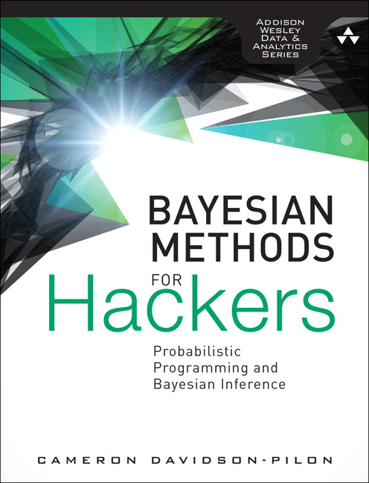
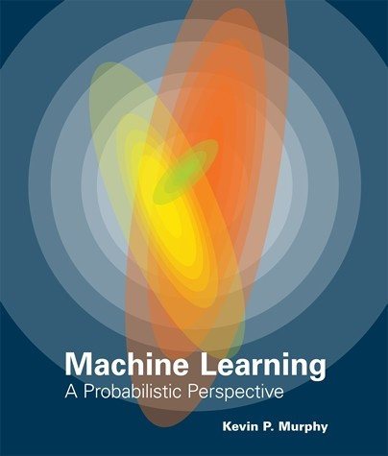
Bibliography
https://github.com/CamDavidsonPilon/Probabilistic-Programming-and-Bayesian-Methods-for-Hackers

Slide 20
“Hello World!”

Slide 21

Monty Hall Problem
Suppose you're on a game show, and you're given the choice of three doors: Behind one door is a car; behind the others, goats. You pick a door, say No. 1, and the host, who knows what's behind the doors, opens another door, say No. 3, which has a goat. He then says to you, "Do you want to pick door No. 2?" Is it to your advantage to switch your choice?

Slide 22


Monty Hall Problem
Suppose you're on a game show, and you're given the choice of three doors: Behind one door is a car; behind the others, goats. You pick a door, say No. 1, and the host, who knows what's behind the doors, opens another door, say No. 3, which has a goat. He then says to you, "Do you want to pick door No. 2?" Is it to your advantage to switch your choice?

Slide 23

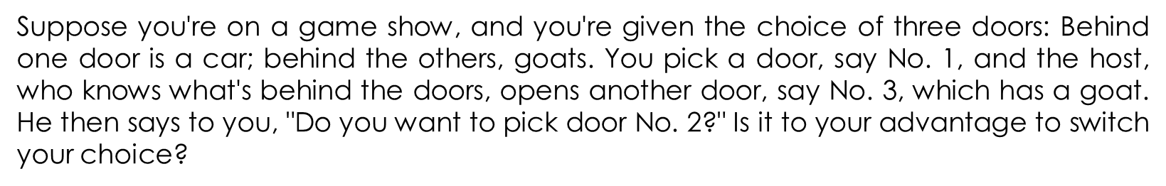
Monty Hall Problem

Slide 24
PyMC Solution
import pymc as pm
car_door = pm.DiscreteUniform("car_door", lower = 1, upper = 3)
picked_door = pm.DiscreteUniform("picked_door", lower = 1, upper = 3)
preference = pm.DiscreteUniform("preference", lower = 0, upper = 1)

Slide 25
PyMC Solution
@pm.deterministic
def host_choice(car_door = car_door, picked_door = picked_door, preference = preference):
if car_door != picked_door: return 6 - car_door - picked_door
if car_door == 1:
left = 2
right = 3
else:
left = 1
if car_door == 2:
right = 3
else:
right = 2
out = right if preference else left
return out

Slide 26
PyMC Solution
@pm.deterministic
def changed_door(picked_door = picked_door, host_choice = host_choice):
return 6 - host_choice - picked_door

Slide 27
PyMC Solution
model = pm.Model([car_door, picked_door, preference, host_choice, changed_door])
mcmc = pm.MCMC(model)
mcmc.sample(40000, 10000, 1)
car_door_samples = mcmc.trace('car_door')[:]
picked_door_samples = mcmc.trace('picked_door')[:]
changed_door_samples = mcmc.trace('changed_door')[:]
print()
print()
print("probability to win of a player who stays with the initial choice:",
(car_door_samples == picked_door_samples).mean())
print("probability to win of a player who switches:",
(car_door_samples == changed_door_samples).mean())

Slide 28
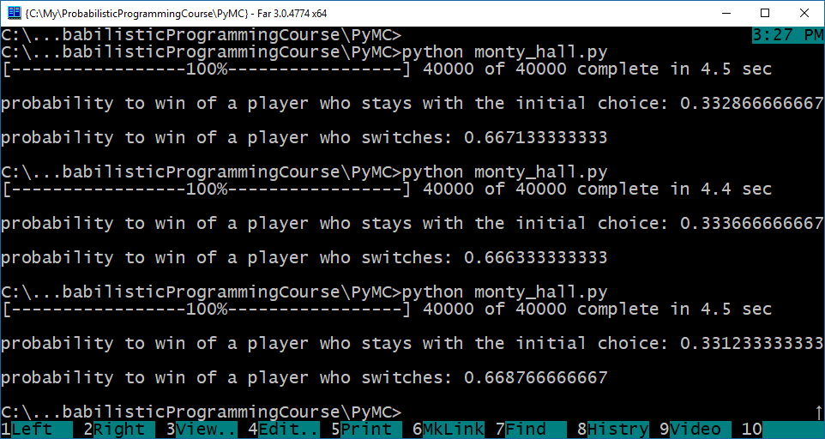
PyMC Solution

Slide 29
Administrative Details

Slide 30
Two Project Assignments
 | Release date | Due date
Project 1 | Week 7 | Week 10
Project 2 | Week 11 | Week 14
The two assignments will be graded from 0 to 10
Collaboration: All students must work individually
Any late submissions are penalized at a rate of 20% per week

Slide 31
Grading
Project 1 – 35%
Project 2 – 35%
Exam - 30%

